Slide 1
PLANT DISEASE DETECTION USING MACHINE LEARNING
BY:
KUSHAL R U– 1RV22CS093
MANOJ KUMAR B V– 1RV23CS407
MOHAMMED ADNAN – 1RV23CS409
NAGAPRASAD NAIK– 1RV23CS410

Slide 2
PRESENTATION CONTENTS
Introduction
Problem Statement
Objectives
Relevance to the Topic
Literature Survey
Methodology
Conclusion

Slide 3
INTRODUCTION
Efficiently ensuring optimal plant health and maximizing crop yields in modern agriculture is a significant challenge. Traditional farming methods depend significantly on manual observation and broad-spectrum care, which can result in inefficiencies and potential losses due to undetected issues like pests, diseases, or unfavorable growing conditions.This project, "Plant Disease Detection Using Machine Learning," aims to address these challenges by leveraging advanced machine learning techniques combined with discrete mathematics to enhance the accuracy and efficiency of plant disease detection.

Slide 4
PROBLEM STATEMENT
Problem Statement: Plant Disease Detection using Machine Learning
In modern agriculture, maintaining optimal plant health and maximizing crop yields is a significant challenge. Traditional farming methods often rely on manual monitoring and generalized care, which can lead to inefficiencies and potential losses due to undetected issues such as pests, diseases, or suboptimal growing conditions. The lack of real-time data on critical environmental parameters and plant health indicators results in delayed responses to problems, affecting crop quality and yield.

Slide 5
PROBLEM STATEMENT
Relevance of the Topic: Plant Disease Detection using Machine Learning
Why It Is Required: Problems It Solves:
Increased Efficiency and Productivity Manual Monitoring Inefficiencies
Sustainable Agriculture Delayed Problem Detection
Real-Time Monitoring and Response Climate Variability
Labor Optimization Economic Viability
Data-Driven Decision Making Prevents Resource Waste

Slide 6
Machine Learning Model
Convolutional Neural Network (CNN) Architecture:
The model includes multiple convolutional layers (Conv2D). Convolutional layers apply convolution operations to the input, which helps in extracting features such as edges, textures, and patterns from the images.
Each Conv2D layer is followed by a ReLU (Rectified Linear Unit) activation function (activation='relu'), which introduces non-linearity to the model and helps it learn complex patterns.
After each convolutional layer, a max-pooling layer (MaxPooling2D) is added. Max-pooling layers reduce the spatial dimensions of the feature maps, which helps in reducing the computational complexity and controlling overfitting.

Slide 7
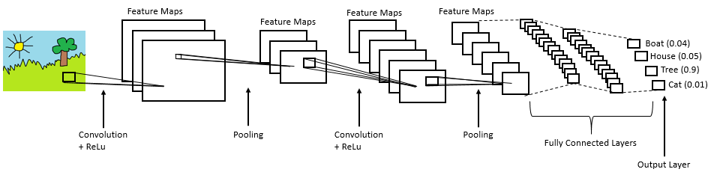

Slide 8
Machine Learning Model
The model includes a fully connected layer (Dense) with 512 neurons and a ReLU activation function. This layer learns to combine the features extracted by the convolutional and pooling layers to make predictions.
DMS concepts:
Graph Theory:
Network Structure: The entire CNN can be viewed as a directed acyclic graph (DAG), where each node represents a layer, and edges represent the flow of data.
Neural Connections: The connections between neurons in consecutive layers can be represented as a graph, with weights on the edges representing the strength of these connections.

Slide 9
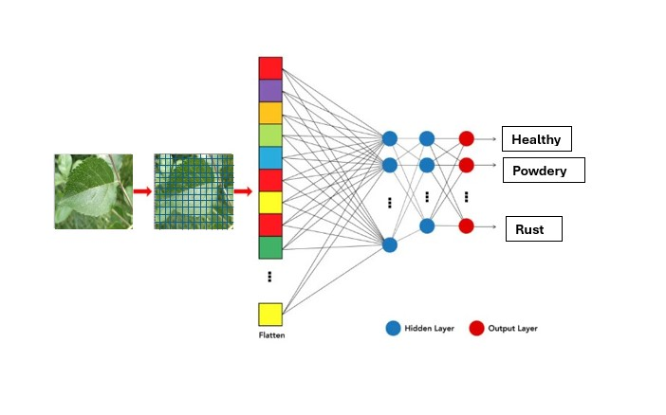

Slide 10
Machine Learning Model
Set Theory:
Training and Validation Sets: The data is divided into distinct sets (training, validation, and test sets). Each set is a collection of examples used for specific purposes in the learning process.
Feature Maps: The collection of features extracted from the images at various convolutional layers can be considered as sets.

Slide 11
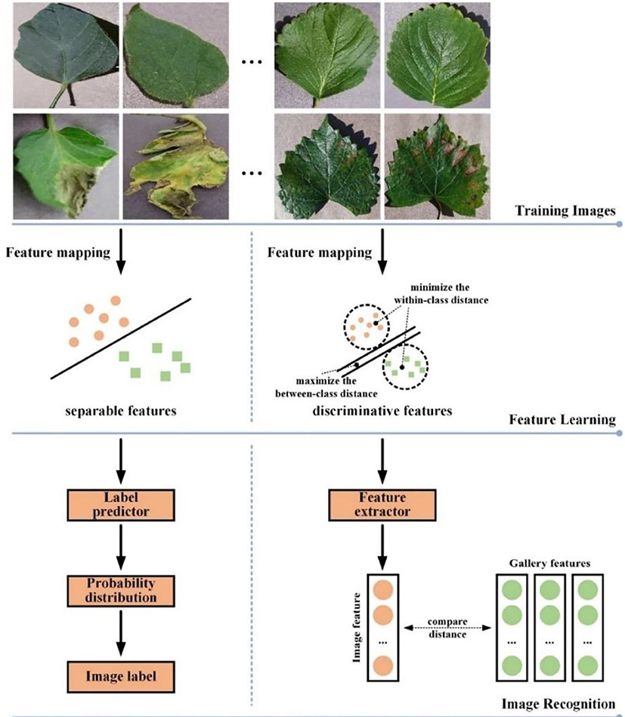

Slide 12
Machine Learning Model
Probability and Statistics:
Softmax Function: The output layer uses the softmax function, which involves probabilistic interpretation. It converts raw output scores into probabilities that sum to 1.
Loss Function: The cross-entropy loss used in training is based on probability theory and measures the difference between the predicted probability distribution and the actual distribution.
Data Augmentation: Techniques like random rotations, flips, and shifts applied to images introduce randomness, which is grounded in probability theory.

Slide 13
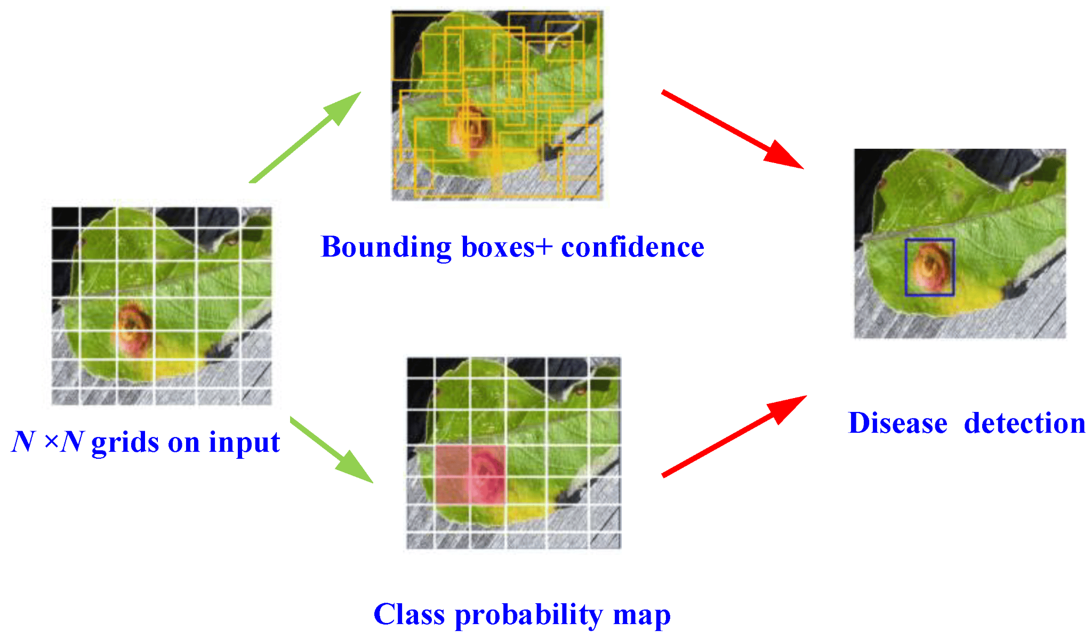

Slide 14
Machine Learning Model
Linear Algebra:
Convolution Operations: Convolutions can be described using matrix operations, where filters are matrices that slide over the input image matrix to produce feature maps.
Matrix Multiplications: In fully connected layers, the operations are essentially matrix multiplications between weights and input vectors.
Boolean Algebra:
ReLU (Rectified Linear Unit) activation functions involve basic Boolean operations (thresholding, comparing values to zero).
These functions help introduce non-linearity into the model, allowing it to learn complex patterns from data.

Slide 15
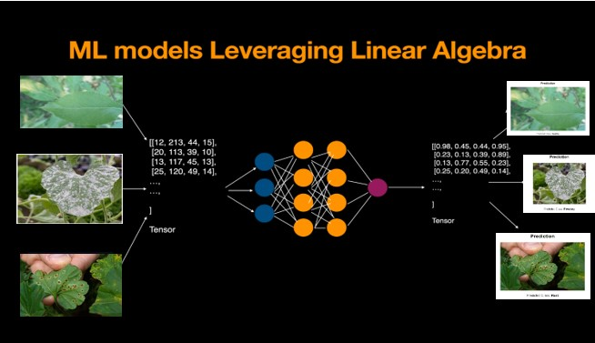

Slide 16
LITERATURE REVIEW
Sl No | Paper Title, Author(s),Year | Author(s) | Summary
1 | A Review of Convolutional Neural Network-based Approaches for Disease Detection in Plants 2022 | Barsha Biswas, Rajesh Kumar Yadav, Department of Computer Science & Engineering, Delhi Technological University, Delhi, India | In India, where 60.3% of the land is used for agriculture, early detection of plant diseases is crucial to prevent economic losses. Utilizing Deep Learning (DL) and Convolutional Neural Networks (CNNs), farmers can efficiently identify plant diseases from images. This study reviews CNN-based methods for plant disease detection.
2 | Plant Leaf Disease Detection Using Transfer Learning Approach 2019 | D. Yaswanth, S. Sai Manoj, M Srikanth Yadav Department of Information Technology & Computer Applications, Vignan’s Foundation for Science, Technology and Research Guntur, India | This study utilizes transfer learning with pre-trained deep learning models on the 'plant village' dataset from Kaggle to accurately identify plant leaf diseases. The approach enhances detection accuracy and generalizes well across different plant species and diseases.

Slide 17
LITERATURE REVIEW
Sl No | Paper Title, Author(s),Year | Author(s) | Summary
3 | An Efficient Model for Plant Disease Detection in Agriculture Using Deep Learning Approaches 2018 | Puneeth N. Thotad, Shanta Kallur, Anupama Nandeppanavar Dept. of Master of Computer Applications, K.L.E. Institute of Technology, Hubballi, India | Detecting plant diseases is vital due to their significant impact on plant growth. This study employs deep learning, specifically Convolutional Neural Networks (CNNs), to analyze a plant-village dataset of 54,306 images. The models achieved a 95% accuracy rate in identifying plant disease symptoms, and an efficient web-based application was developed for crop disease detection.
4 | Deep Learning based Automated Rice Plant Disease Recognition and Classification Model 2019 | D. Felicia Rose Anandhi, S. Sathiamoorthy Department of Computer and Information Science, Faculty of Science, Annamalai University | This study utilizes Deep Learning (DL) techniques, specifically the DL-ARPDRC approach, combining VGG-19 for feature extraction and XGBoost for classification. The method includes image pre-processing and segmentation, achieving superior performance in identifying rice plant diseases.

Slide 18
METHODOLOGY
The primary objective of this project is to detect and classify plant diseases from leaf images. Early detection is important because it allows for timely intervention, which can prevent widespread damage and loss of crops. This, in turn, improves agricultural productivity and supports food security.

Slide 19
Dataset Preparation and Preprocessing
Data source: Kaggle dataset
Structure: Train, Test, Validation folders
Classes: Healthy, Powdery Mildew, Rust
Image loading
Resizing and normalization
Data augmentation

Slide 20
2. Model Building and Training
CNN architecture
Convolutional and pooling layers
Dense layers for classification
Compilation: Optimizer, loss function, metrics
Training with validation split
Early stopping and model checkpointing

Slide 21
3. Prediction and Visualization
Function to load and predict new images.
Here, we upload a new image and predict the class, which class does it belong to among Healthy, Powdery Mildew and Rust through the trained model.

Slide 22
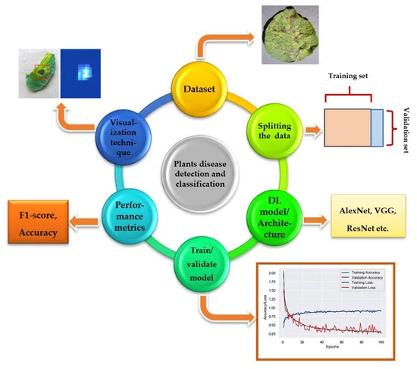

Slide 23
CONCLUSION
The use of Convolutional Neural Networks (CNNs) for plant disease detection and classification represents a significant advancement in agricultural technology. This approach leverages the power of deep learning to automatically identify and classify various plant diseases from images, providing a robust tool for farmers and agronomists.

